Slide 1
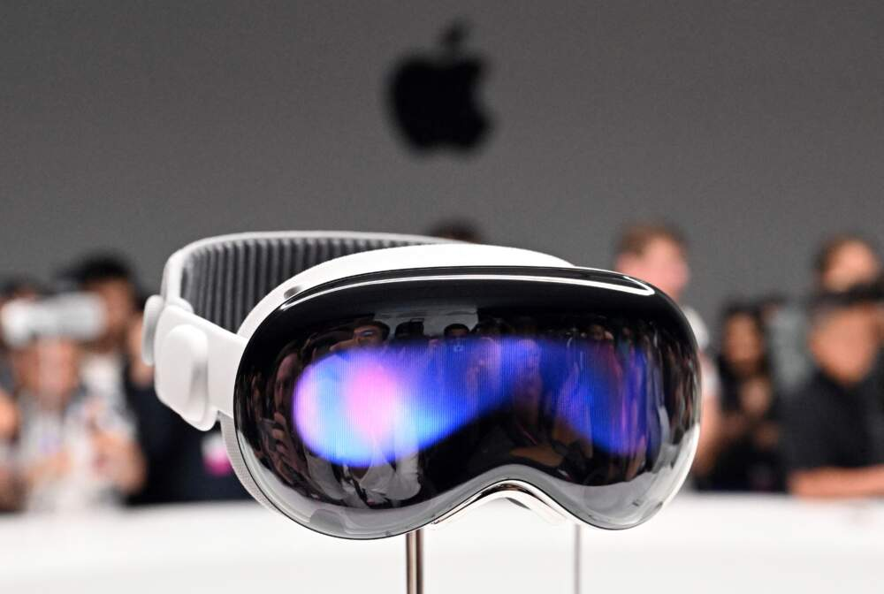
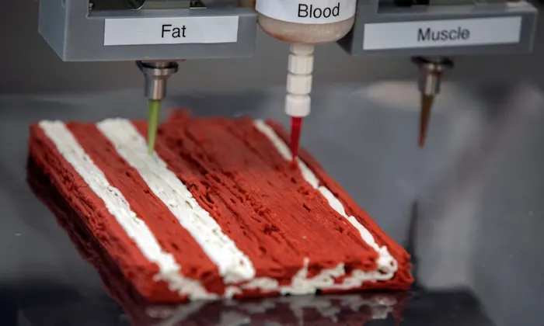
Latest Inventions
For us
For science
Virtual reality
Smart home
Smart phones
Neuralink
Reusable rockets
3D Food printing
Artificial intelligence

Slide 2
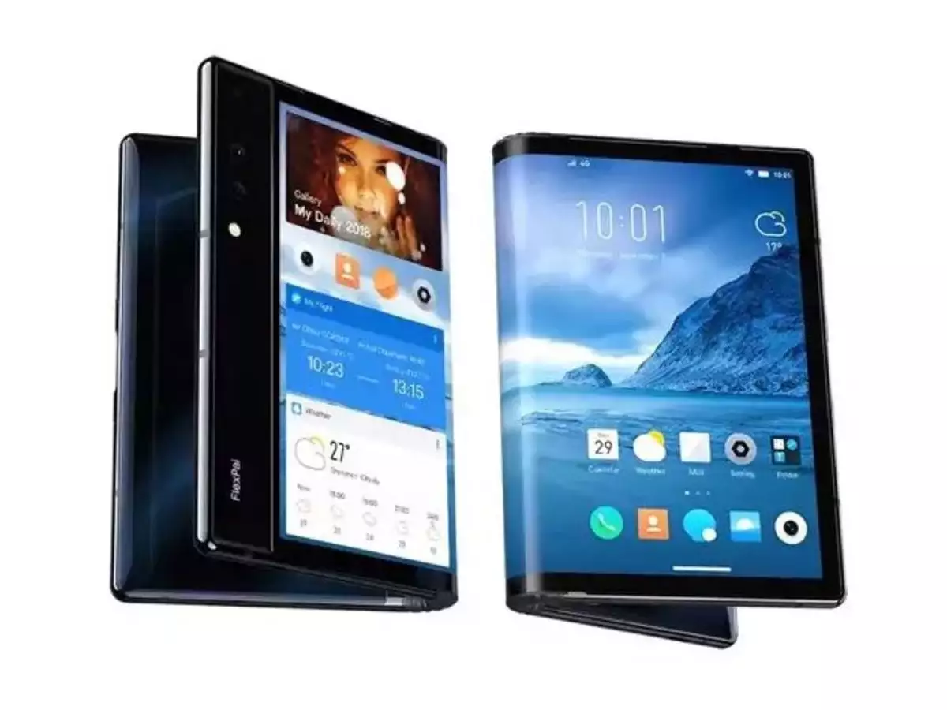
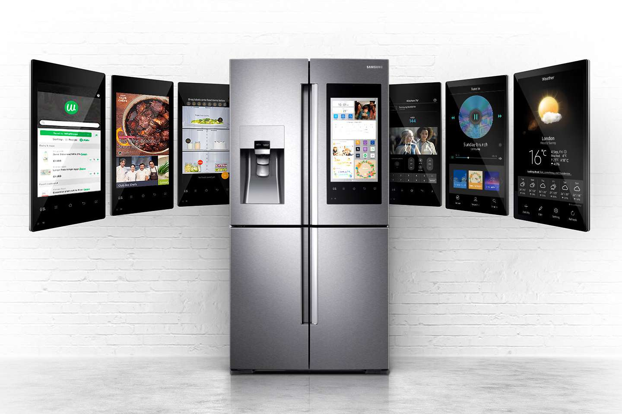
Everyday Life -
at Home
Foldable devices
Smart home
Robot vacuum cleaner
Home entertainment devices
Smart fridge

Slide 3
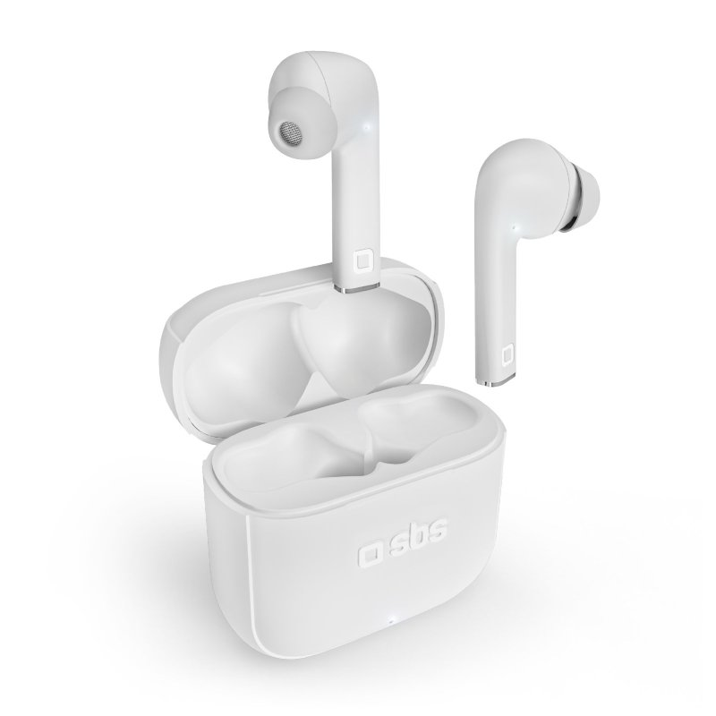
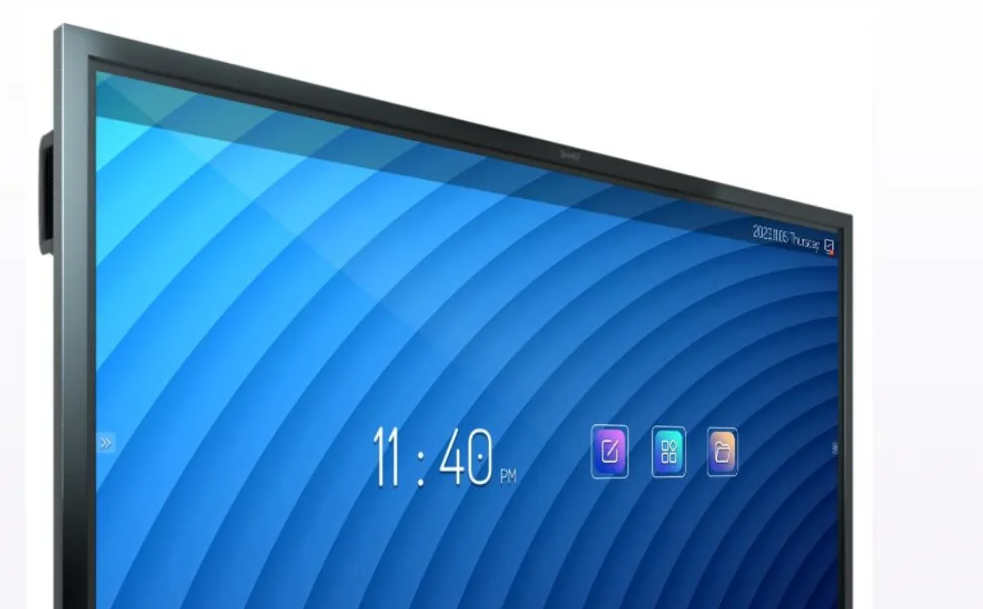
Everyday Life at School & Work
Wireless earbuds
Laptop
Printer
Projector
Electric board

Slide 4

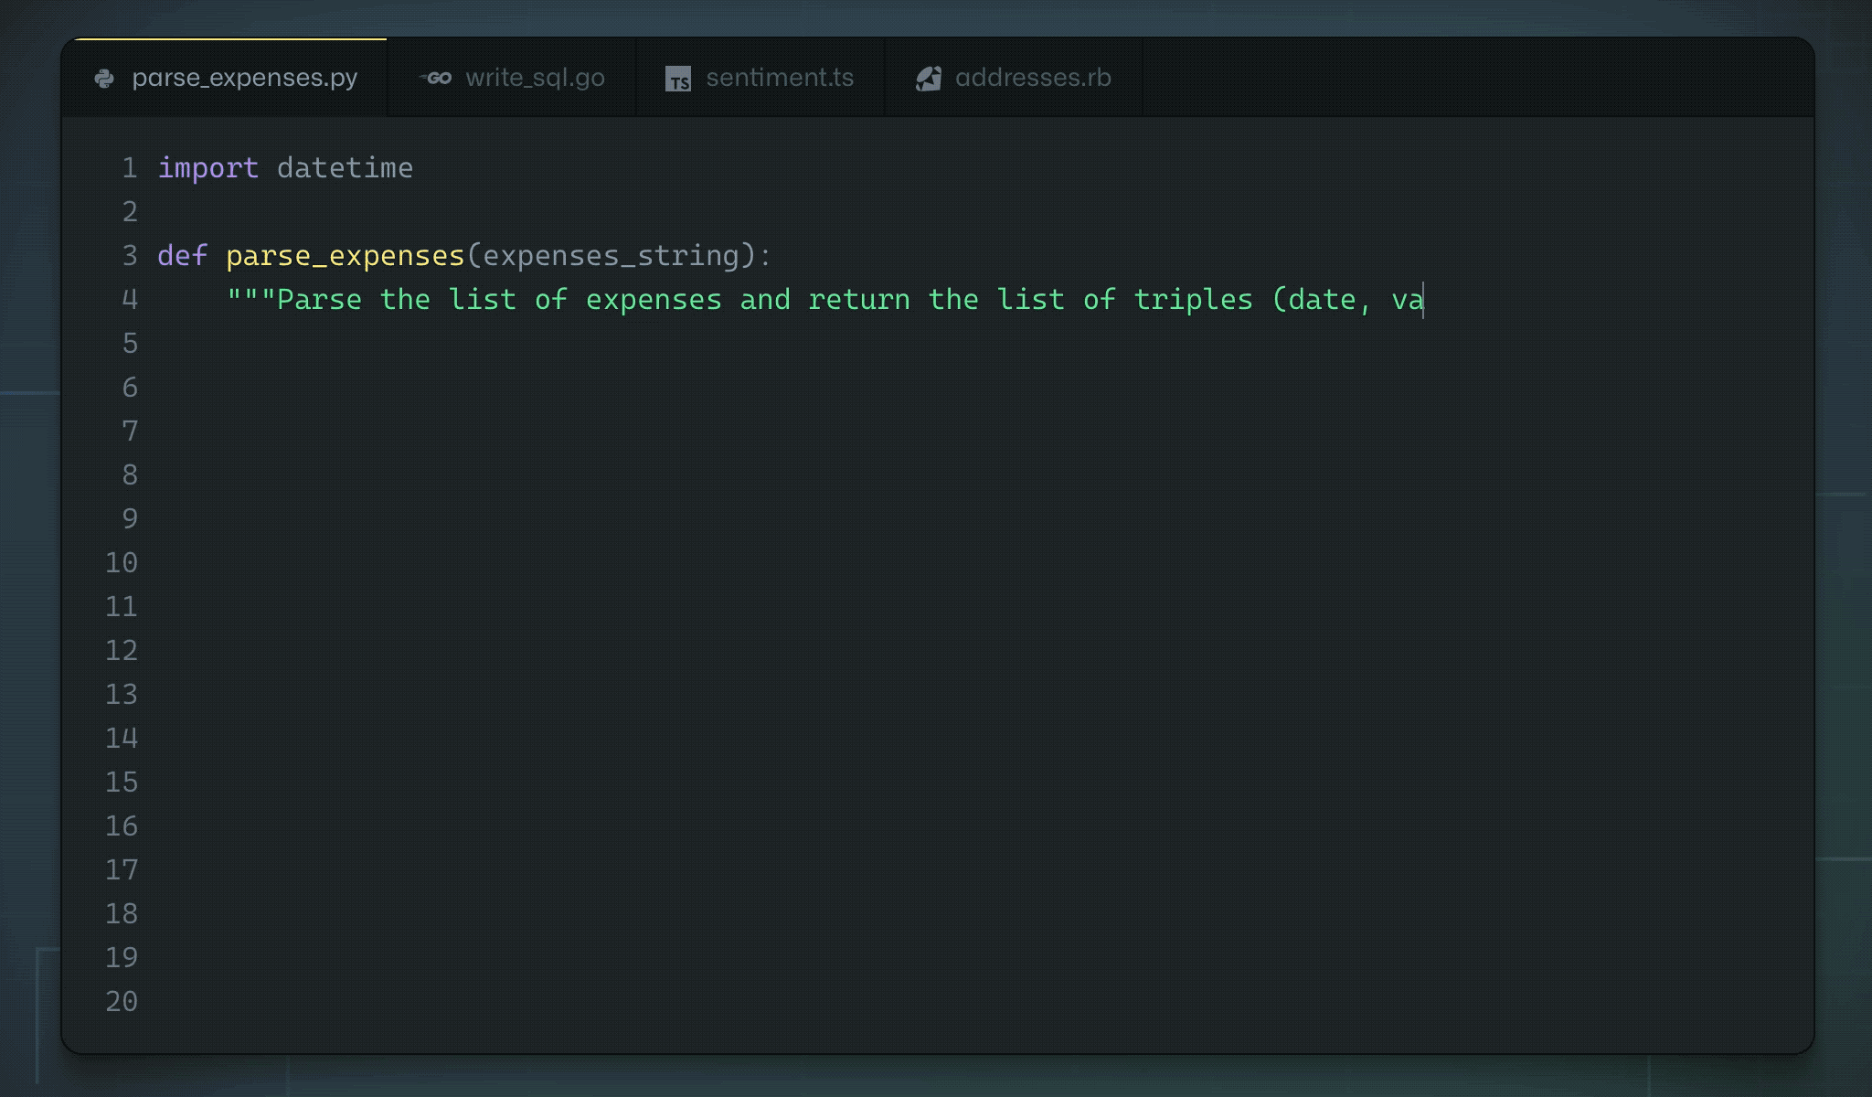
What do we use it for
Generate source code with AI
Listen to music anywhere with wireless earbuds
To make our life easier & comfortable

